Slide 1
ORIENTATION PROGRAM ON PRODUCTION OF ACCESSIBLE DIGITAL BOOKS IN DAISY FORMAT
Satyajeet Singh

Slide 2
CAN EVERYONE READ THE STANDARD PRINT? (Books, magazines, newspapers, etc)

Slide 3
CAN EVERYONE READ THE STANDARD PRINT? NO
People with print impairments cannot read the standard print because of:
Visual Impairment (blindness or low vision)
Cognitive disabilities such as dyslexia, autism, slow learners, ADHD, etc
Physical disabilities that limit one’s ability to hold a printed book
Old Age

Slide 4
The Alternatives to Print are:
Braille Books
Large print book
Audio Cassettes
MP3 format audio CDs
Accessible electronic books (e-books)
HTML-based books
DAISY Talking Books

Slide 6
Less than 5% books are available in accessible formats it is a “BOOK FAMINE” for people with print disabilities.

Slide 7
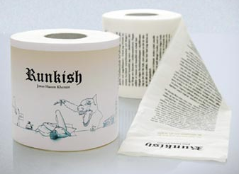

Slide 8
The reading experience of people with disabilities has been that of “books printed on toilet paper”

Slide 9
Concepts of Accessible Content
Structure: sequential and hierarchical structure of the publication
Navigation: Global and Local
Rich Reading Experience
Notes:
Global navigation is movement to a specific point or portion of a book (for example, a chapter, part or page, or the index).
Local navigation is movement within a single text element (such as a list or table) or within a narrow range of text elements (such as a group of words, sentences or paragraphs). It is analogous to skimming a printed book.

Slide 10
Why DAISY?
DAISY IS THE BEST WAY TO READ & PUBLISH
Accessible for individuals unable to read standard print
Navigable, providing direct access to specific points such as pages and enabling readers to move from heading to heading, page to page, paragraph to paragraph, phrase to phrase and/or word to word.
A DAISY book reflects, as closely as possible, the original print publication

Slide 11
Accessibility Features
Jumping to any page of the book
Jumping to next or previous chapter or sub-section
Moving to next or previous sentence
Moving to next or previous phrase or even character

Slide 12
Accessibility Features
Advanced Functionality
‘Go to page’
Bookmarking
Speed up/slow down without distortion
An all-inclusive format.

Slide 13
DAISY for All
DAISY is for all ages, languages and for all purposes:
Pre-school
Elementary and secondary school
Post-secondary
Career, start to finish
Retirement

Slide 14
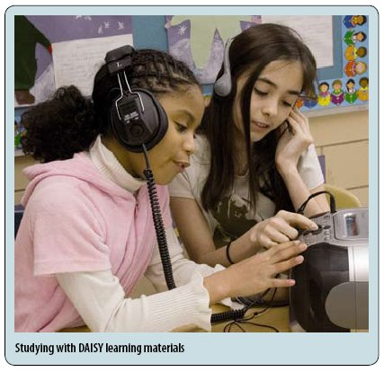
EFFECTIVE EDUCATION
Combined text and audio can increase learning effectiveness by nearly 50%
United Nations recommends DAISY for Information and Communications Technology (ICT) serving persons with disabilities.

Slide 15
The DAISY Forum of India
DAISY Forum of India is a forum of Not for Profit organizations from India started in 2007.
These organizations are involved in production and distribution of books and reading materials in accessible formats for persons who cannot read normal print.

Slide 16
Types of DAISY books
Full audio with Navigation
Text and no audio
Full audio and full text

Slide 17
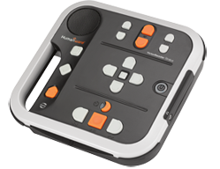
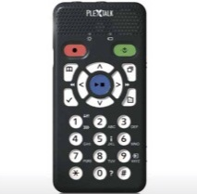
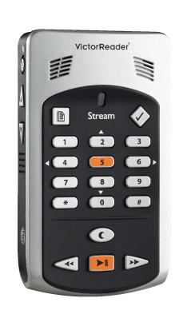
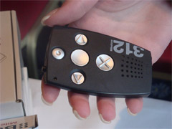
DAISY Book Players
Hardware Options
Examples
PlexTalk Portable Recorder
Victor Stream
Victor Stratus
Milestone
Holisen Text Player
Can also be played track-wise on normal CD/mp3 players for those who do not have Daisy players.

Slide 18
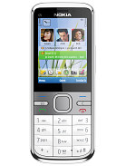
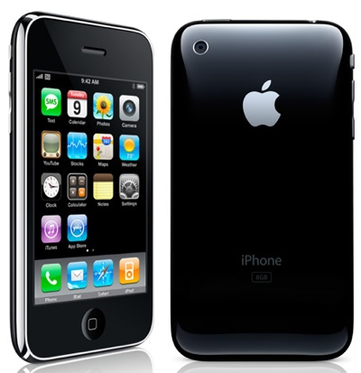
DAISY Book Players
Mobile Options
For Symbian Nokia phones
Nuance DAISY2Go
For Android
DAISY / EPUB Reader
Darwin DAISY Reader App
Go Read
For iPhone, iPod touch and iPad
Daisylezer App
DaisyWorm App
Learning Ally Audiobook Player App
Read2Go App

Slide 19
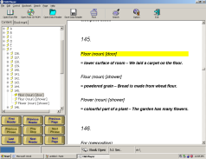
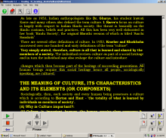
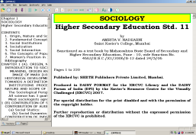
DAISY Book Players
Software Options
AMIS
Dolphin Ease Reader
eClipse Reader
TAB Player
FS Reader
Read Hear
Many more…

Slide 20
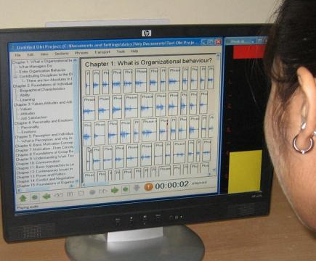
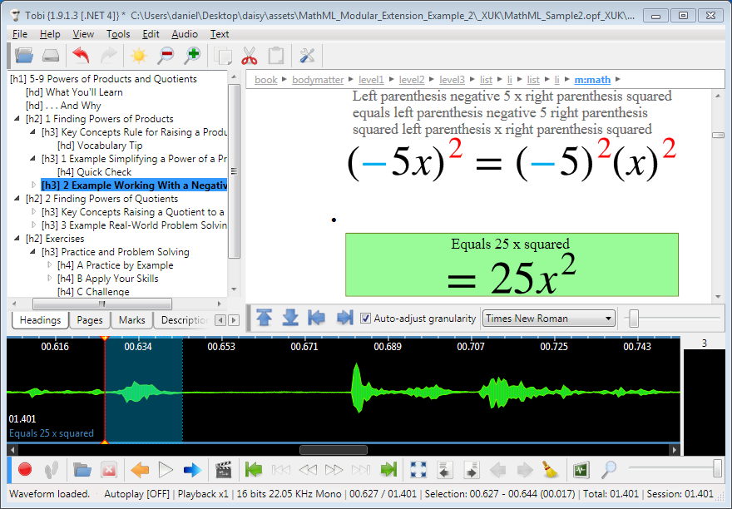
Production Tools
My Studio PC
Obi
Microsoft Save as DAISY
Tobi
Dolphin Publisher
Many more…

Slide 21
THANK YOU

